Slide 1
Database Project
Clinic database management for CNCS

Slide 2
Overview
With the advent of computers and its related technology, in which everything needs to be done efficiently and effectively the existences of Automated Clinic Record become necessary. Add your second bullet point here
If this automation becomes successful it will be an easier way to retrieve student’s records without any difficulty. And it will also solve the flaws of manual system such as the problem of misplacement or missing record.
Notes:
Don’t forget to explain beneficiaries and benefits!!!

Slide 3
Scope and Objectives
Scope
• A database system will be introduced to manage the student’s clinic information and daily activity.
• The database can be accessed by both students and nurses. Where only nurses can update or manipulate the database.
General objective
- The general objective of our project is to automatize the paper-based data handling system of Addis Ababa University clinic.
Specific objectives
• Identify problems of the existing data handling system
• Evaluate the use of automatized data handling system
• Identify and analyze the requirements that must be involved in the system
• Choose the most appropriate technology tools for automatizing the existing system of data handling
• Design and implement the automatized system

Slide 4
Methodology
Data collection methods
Questioner
Interview
Observation
Development tools
Tools for Written Documentation
Microsoft office Word 2016
Visio Professional
Tools for the Implementation Phase
MySQL
Tools for Modeling
Microsoft Visio 2016.
Visual studio Code
Operating Systems
Windows
Linux

Slide 5
Entity Description
Entity | Description
Student | Registered students of college
Medicine | Treatment that is given to the student
Pharmacist | Pharmacists who work in the clinic pharmacy
Lab Test | Test that is done by Lab technician
Lab Technician | Employees who work in college clinic laboratory
Health professional | Employees who work in college clinic i.e. could be nurse/doctor
Table 1. Entity description table

Slide 6
Attribute Description
Entities | Attribute Description
Student | Student ID, StName, age, Dept, mob_num, DOB, emerCont_name, emerCont_mobnum,
Medicine | Medicine_id, medicine_name
Pharmacist | employee_id, mob_num, name
Lab Test | test_no, test_name, test_result
Lab Technician | employee_id, mob_num, name
Nurse/Doctor | employee_id, name, mob_num
Note:- name and StName are the only composite attributes, age is the only derived attribute the rest of the attributes are all normal.
Table 2. Attribute description table

Slide 7
Relationship and Constraint Description
Attribute | Relationship type | Cardinality | Participation
Student – Lab_test – Health professional - Medicine | Treate | N: n:m:M | .------
Medicine - Pharmacist | Give | N:1 | P:F
Lab_test – Lab Technician | Perform | N:1 | P:F
Table 3. Relationship Description table

Slide 8
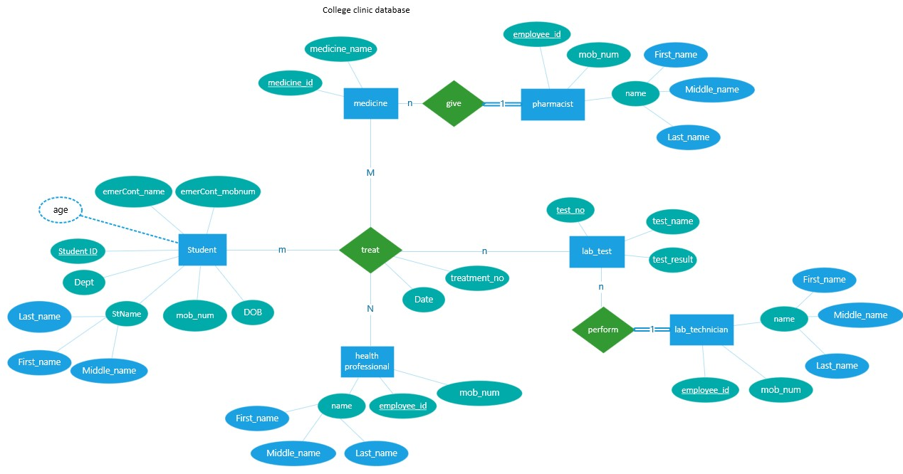
Entity-relation diagram

Slide 9
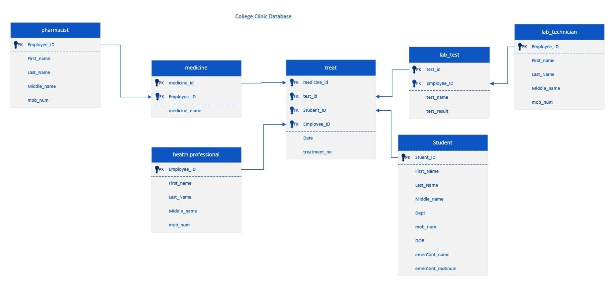
Entity-Relation Table

Slide 10
Validate using normalization
Our Logical data model is already in first normal form since each cell in all the tables is single-valued and entries in a column (attribute, field) are of the same kind.
Our Logical data model is already in second normal form since all relations are in the 1NF and there isn’t any Partial Dependency in any of the relations.
Our Logical data model is already in third normal form since it is in 2NF and there are no transitive dependencies between a primary key and non-primary key attribute in any of the relations

Slide 11
Thank you

